Slide 1
REACH Antenna Group Weekly Meeting 01 25 March 2019

Slide 2
Overview
EDGES High-band Antenna Resimulation
FEKO Modelling
S-Parameters
Gain Pattern vs. Frequency
Pyramidal Sinuous Antenna
Antenna Geometry
S-Parameters
Two-Arm Model
Two Arm Model with Truncation
Two-Arm Model with Truncation and Loads

Slide 3
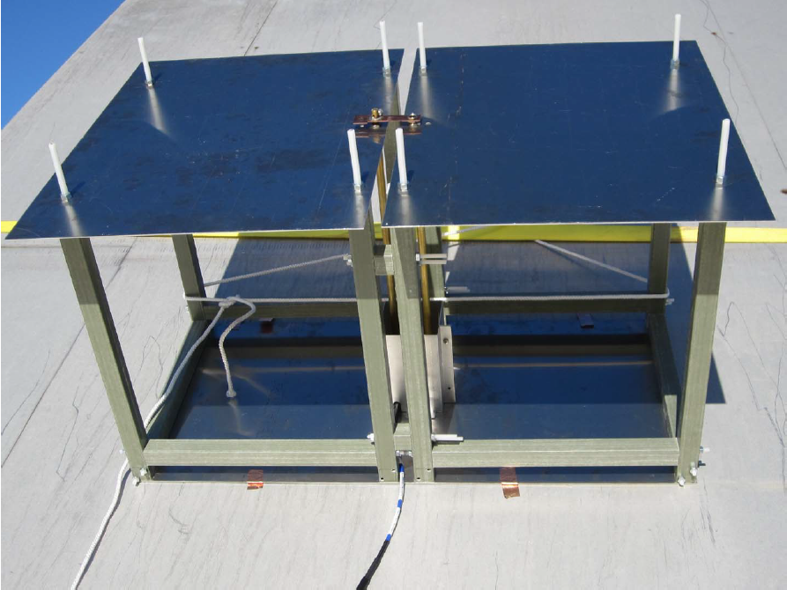
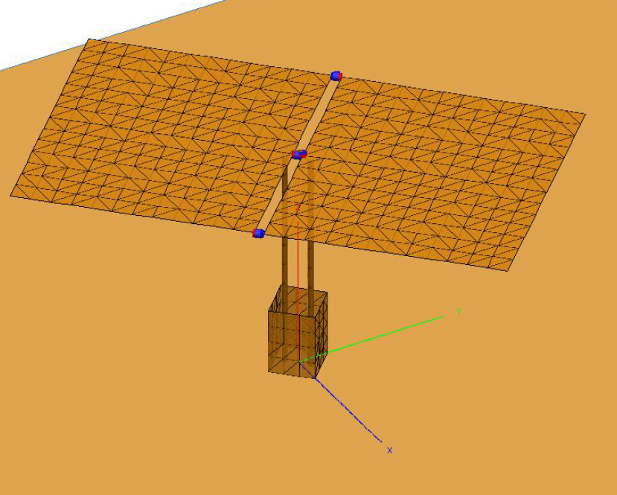
EDGES High-band Antenna
EDGES HBA Prototype
EDGES HBA original FEKO model

Slide 4
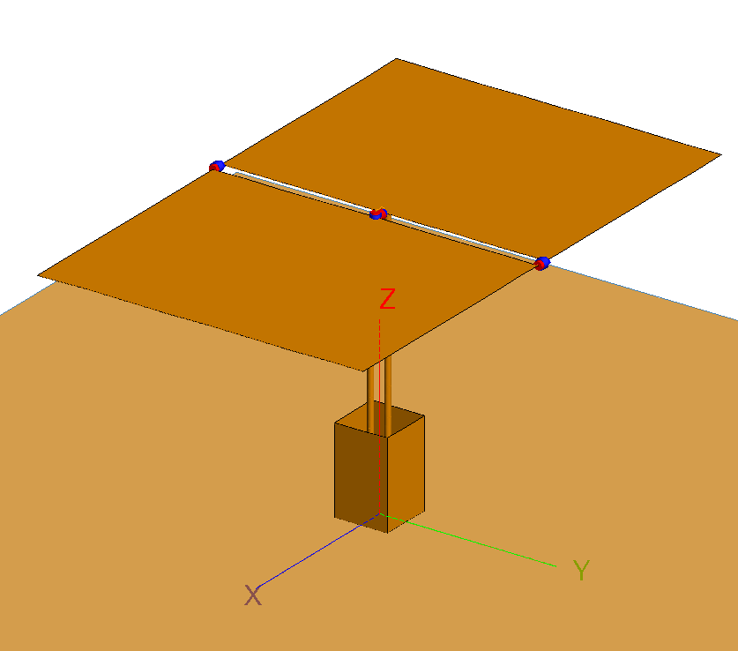
EDGES High-band Antenna – FEKO Resimulation
EDGES HBA FEKO resimulation

Slide 5
EDGES High-band Antenna – FEKO Resimulation
0.5 pF
tip capacitors
EDGES HBA FEKO resimulation

Slide 6
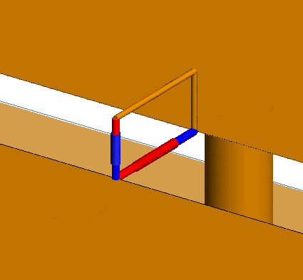
EDGES High-band Antenna – FEKO Resimulation
5 pF top capacitor
50 Ω wire port
EDGES HBA FEKO resimulation

Slide 7
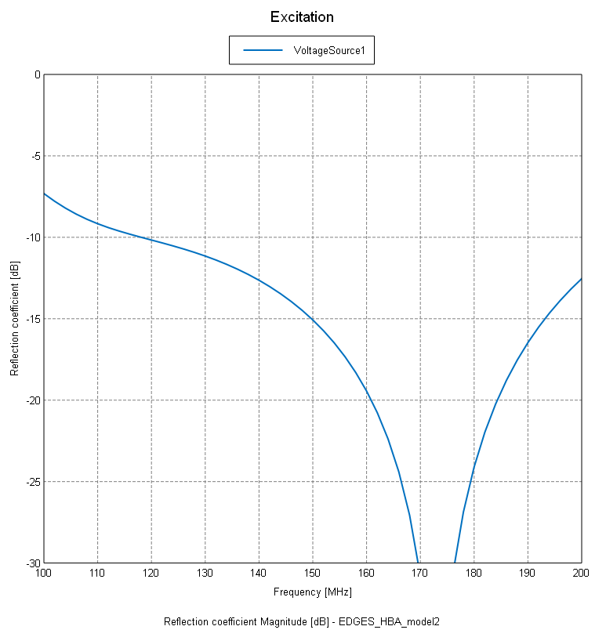
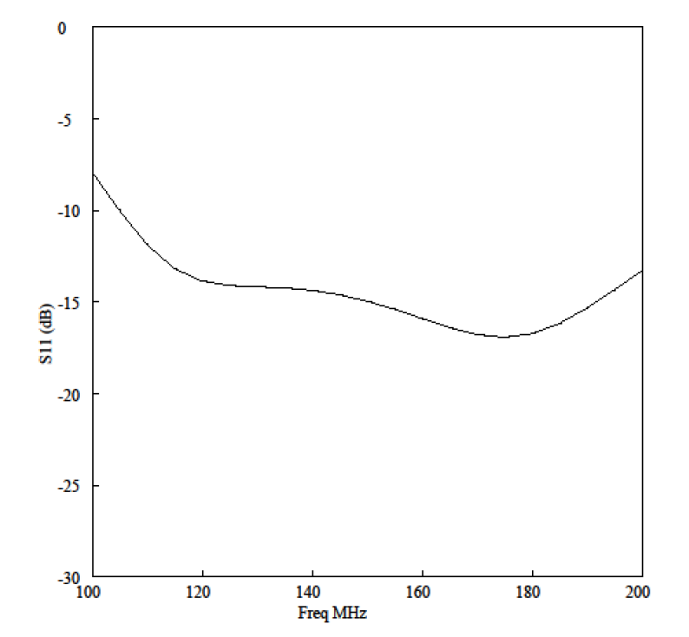
EDGES High-band Antenna – Reflection Coefficient

Slide 8
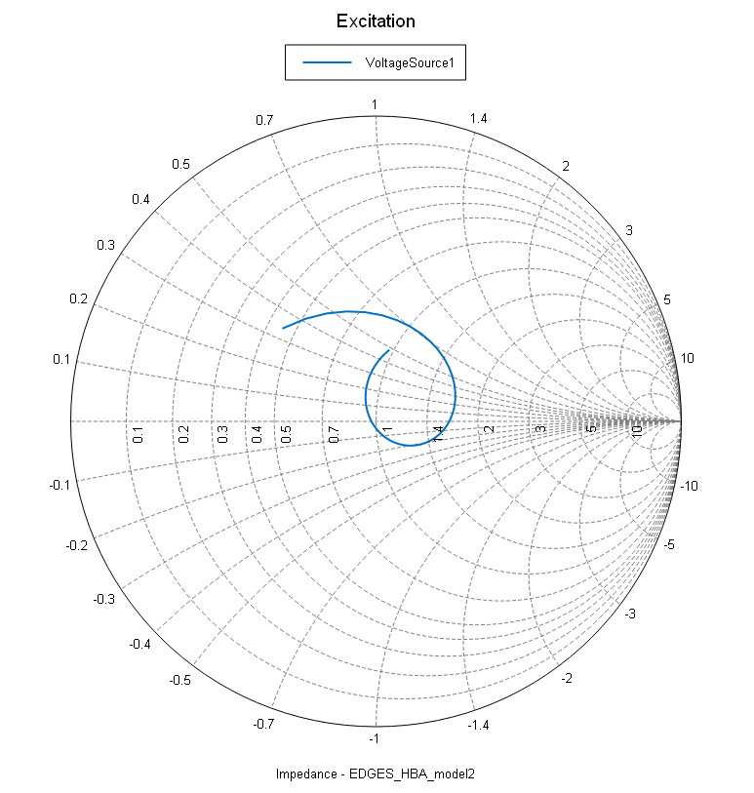
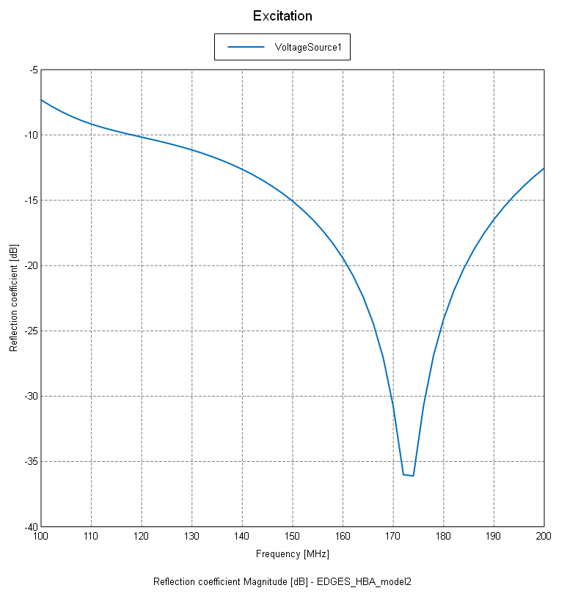
EDGES High-band Antenna – Reflection Coefficient

Slide 9
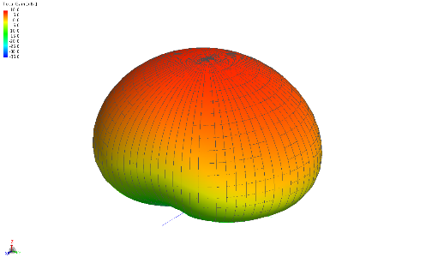






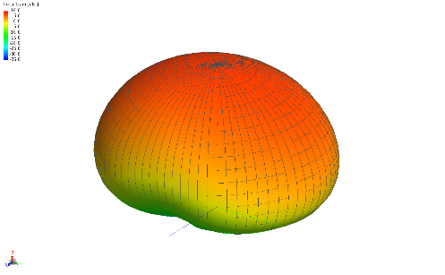

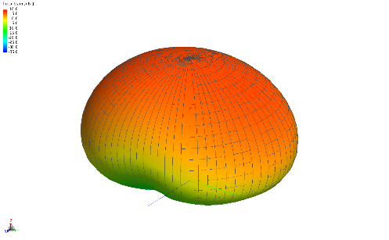
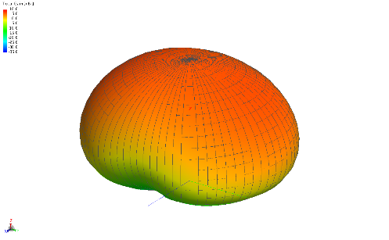
EDGES High-band Antenna – Gain Patterns
100 MHz
110 MHz
120 MHz
130 MHz
140 MHz
150 MHz
160 MHz
170 MHz
180 MHz
190 MHz
200 MHz

Slide 10
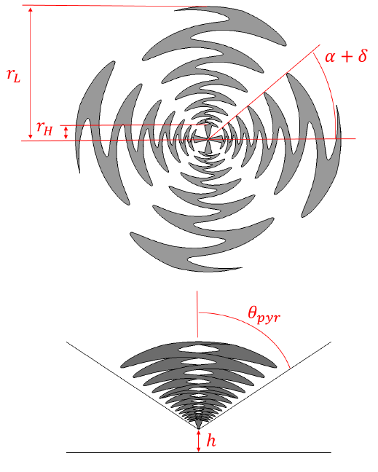
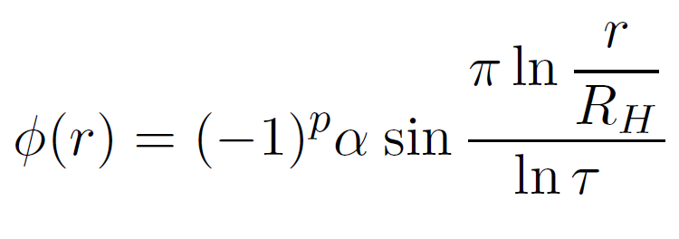
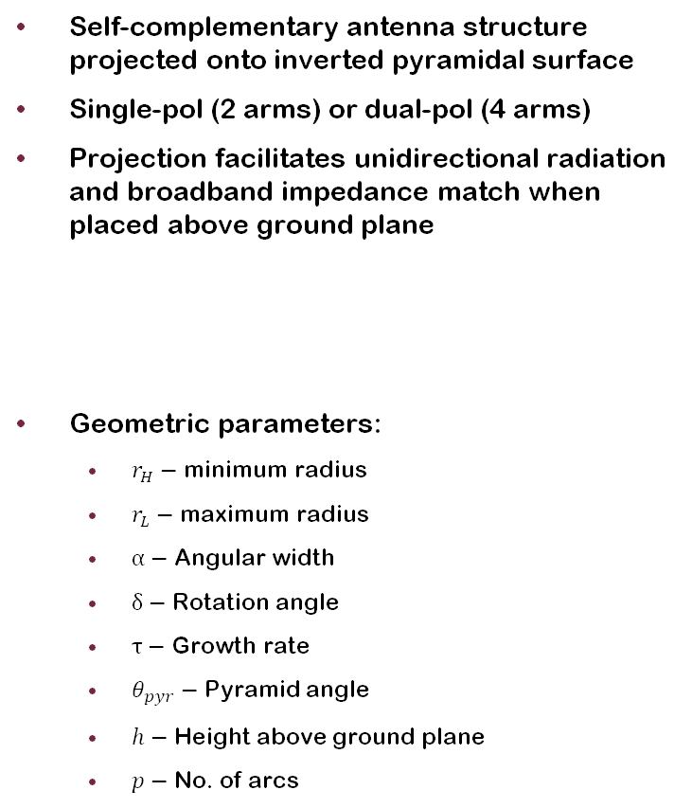
Pyramidal Sinuous Antenna
Self-complementary antenna structure projected onto inverted pyramidal surface
Single-pol (2 arms) or dual-pol (4 arms)
Projection facilitates unidirectional radiation and broadband impedance match when placed above ground plane
Geometric parameters:
$r_{H}−$ minimum radius
$r_{L}−$ maximum radius
$α−$ Angular width
$δ−$ Rotation angle
$τ−$ Growth rate
$θ_{pyr}−$ Pyramid angle
$h−$ Height above ground plane
$p−$ No. of arcs

Slide 11
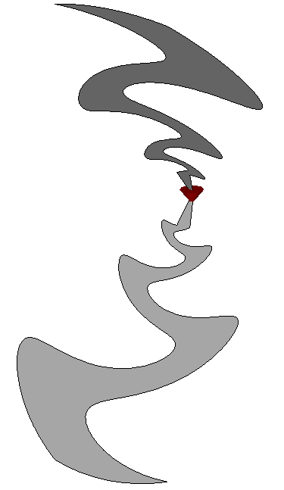
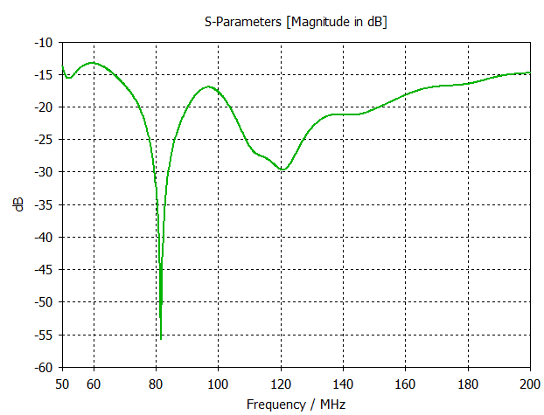
Two-Arm Model

Slide 12
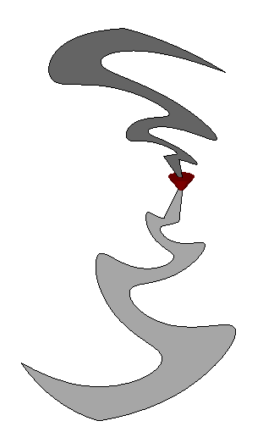
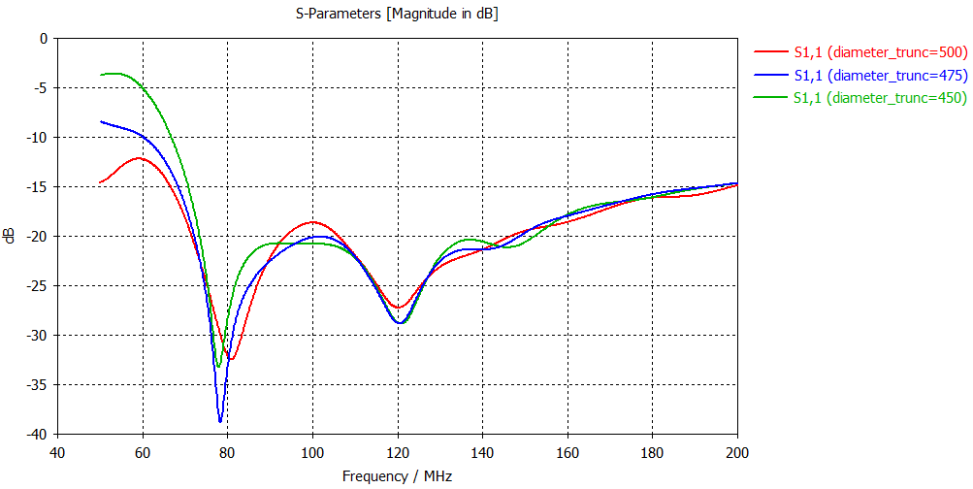
Two-Arm Model with Truncation

Slide 13
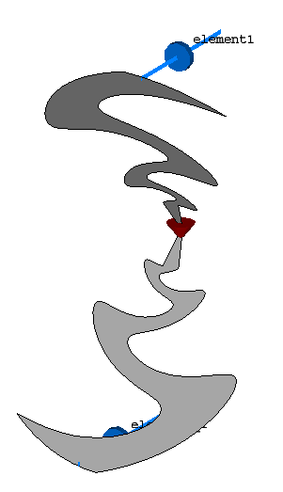
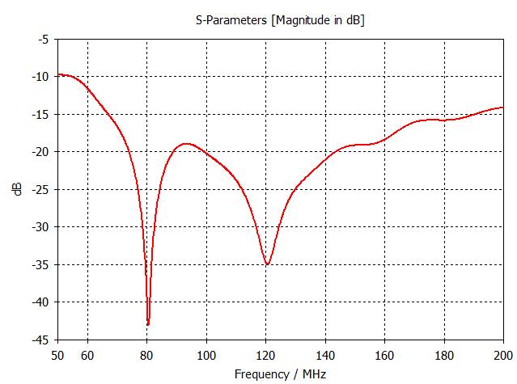
Two-Arm Model with Truncation and Loads

Slide 14
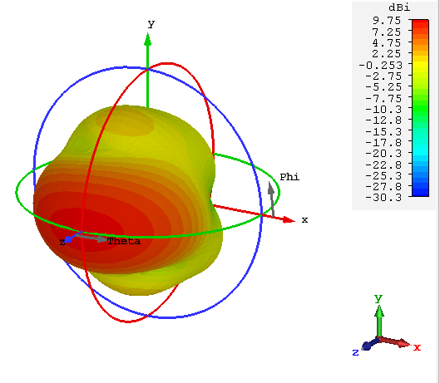
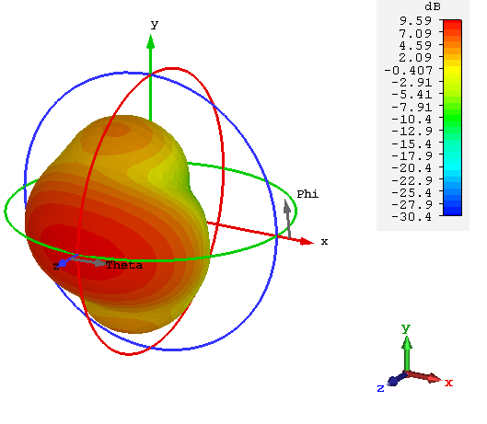
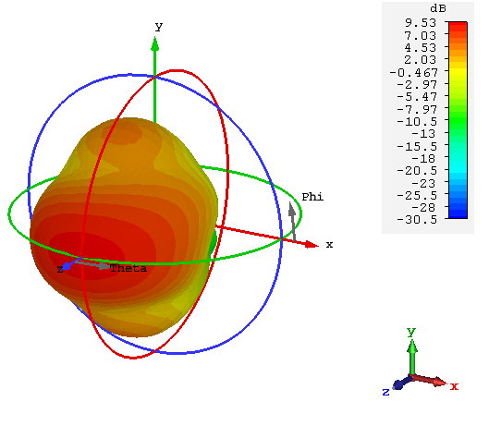
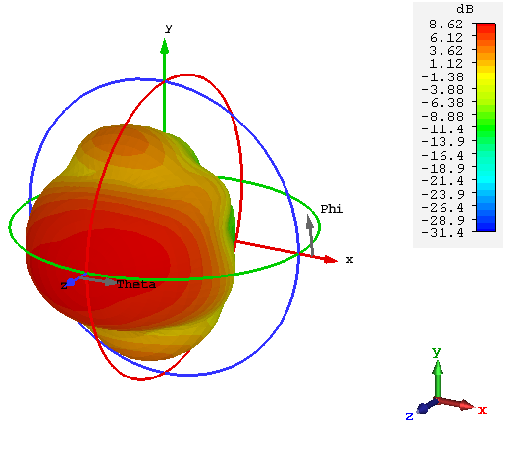
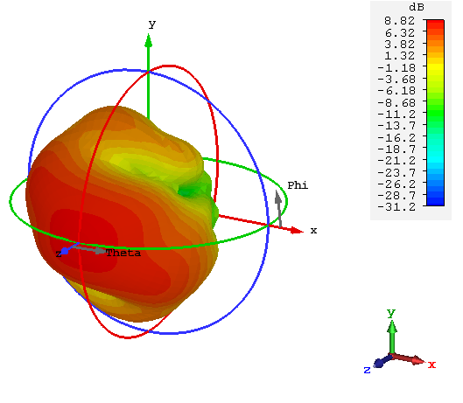
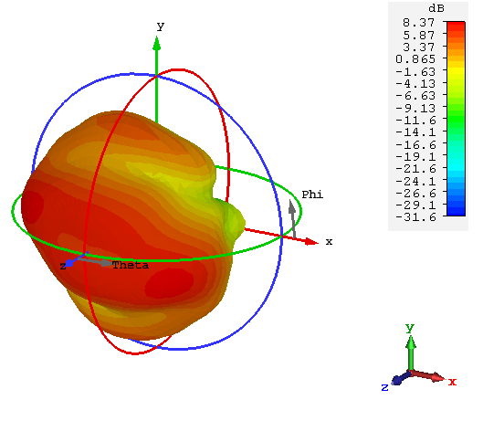
Two-Arm Model with Truncation and Loads – Gain Patterns
50 MHz
80 MHz
110 MHz
140 MHz
170 MHz
200 MHz

